Slide 1
Chapter 3 Hardware 3.3 memory

Slide 2
Objective
show understanding of the need for primary storage(主存储器)
– explain the differences between RAM and ROM memory
– explain the differences between Static RAM (SRAM) and Dynamic RAM (DRAM)
show understanding of the need for secondary (including removable) storage
show understanding of the basic internal operation of the following specific types of device:
– hard disk
– solid state (flash) memory
– optical discs

Slide 3
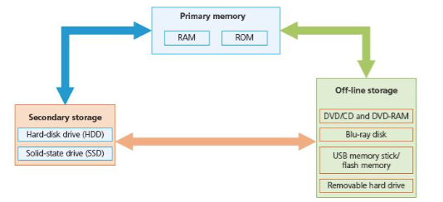
Memory

Slide 4
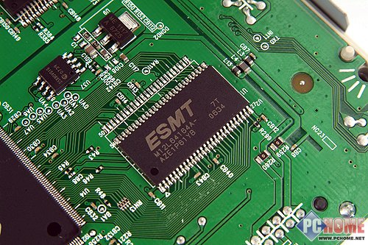

Primary memory
Read Only Memory (ROM)
What are the feature of the ROM ?
ROM holds data that are non-volatile. Once data have been written into a ROM chip, they cannot be changed.
The contents can be read only ; they cannot be modified
The ROM often holds the instructions for starting up the computer

Slide 5
Primary memory
Read Only Memory (ROM)
ROM is typically used in:
• a PC for storage of the boot program code
• a device such as a washing machine for storage of the program code for the various washing programmes.

Slide 6
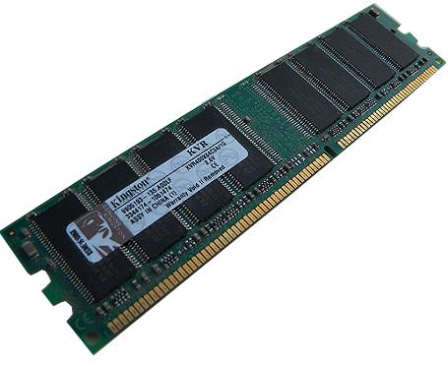
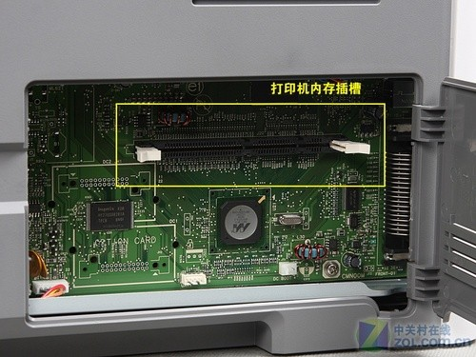
Primary memory
Random Access Memory (RAM)
'Random access' implies that the processor is able to directly access any individual memory location from knowing its address.

Slide 7
Primary memory
Random Access Memory (RAM)
The features of the RAM
It is volatile(易失) memory (the contents of the memory are lost when the power to the RAM is turned off). It can be written or read, and the contents of the memory can be changed.
It is used to store data, files or part of the operating system that are currently in use
RAM is much faster to write to or read from than other types of memory

Slide 8
Two types of RAM
Dynamic Random Access Memory (DRAM) 动态随机存储器
Dynamic random access memory utilizes the amount of charge stored in a capacitor to represent a binary bit. Since the transistor has a leakage phenomenon in reality, periodic charging is unavoidable. Because of this feature that requires a timed refresh, it is called a "dynamic" memory.
动态随机存取存储器利用电容内存储电荷的多寡来代表一个二进制比特。由于在现实中晶体管会有漏电的现象，周期性地充电不可避免。由于这种需要定时刷新的特性，因此被称为“动态”存储器。

Slide 9
Two types of RAM
Static Random Access Memory (SRAM) 静态随机存储器
As long as the SRAM remains powered, the data stored in it can be kept constant. In contrast, data stored in dynamic random access memory (DRAM) needs to be updated periodically. However, when the power supply is stopped, the data stored in the SRAM will disappear, which is different from the ROM or flash memory that can store data after the power is turned off.
静态随机存取存储器只要保持通电，里面储存的数据就可以恒常保持。相对之下，动态随机存取存储器（DRAM）里面所储存的数据就需要周期性地更新。然而，当电力供应停止时，SRAM储存的数据还是会消失，这与在断电后还能储存资料的ROM或闪存是不同的。

Slide 10
Two types of RAM
The features of SRAM
It is faster than DRAM (access time for SRAM is 25 nanoseconds and for DRAM is 60 nanoseconds)
More expensive
Less capacity
The features of DRAM
They are less expensive to manufacture than SRAM
They have a higher storage capacity than SRAM
They consume less power than SRAM

Slide 11
Compare primary storage with secondary storage
Primary storage | Secondary storage
Directly accessible（直接访问） by the processor as it is internal to the computer | Not directly accessible to the processor
Temporarily stores data | Permanently（长久） stores data
Can be read and written almost instantly（立即） | Slower to read data from and write data to, as it needs to be transferred into RAM first
Normally a few gigabytes in capacity | Can be up to a terabytes or more in capacity
Fixed within the computer | Some devices are removable

Slide 12
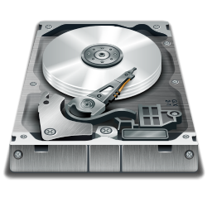
Secondary memory– magnetic storage
Hard disk drive (HDD)
The hard disk is the main method used for data storage in the computer.
Data is stored in a digital format on the magnetic surfaces of the disks.
The hard disk drive will have a number of platters（盘） which can spin（旋转） at about 7000 times a second. Each platter has two surfaces which can be used to store the data.

Slide 13

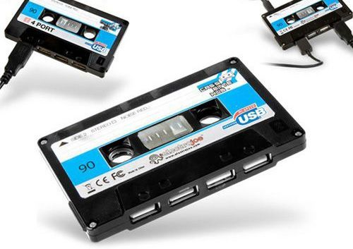
Secondary memory– magnetic storage
Removable hard disk drives are HDD but can be connected to the computer using one of the USB port.
magnetic tape

Slide 14
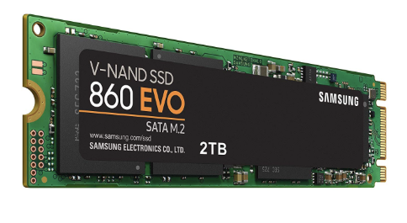
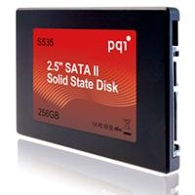
Secondary memory– Solid state (flash) memory
Solid-state devices (SSDs)
Currently most solid-state devices (SSD) use NAND based flash memory, which retains data without power. This is done using transistors
A solid-state memory (SSM) is constructed entirely from electronic components which are designed to perform traditional block input/output (I/O)基于块的读写.

Slide 15
The benefits of using SSD
There are no moving (mechanical, 机械) components.
They are typically more resistant(抵抗) to physical shock.
They run silently.
They have lower access times and latency.
They are lighter.
They have a lower power consumption

Slide 16
The drawback of SSD
Expensive
Lower capacity
Unable to recover data
Questionable longevity of the technology

Slide 17
Secondary memory– USB flash memories
Memory sticks/flash memory use solid-state technology.
Advantage
They are very small, lightweight devices which make them as a a convenient method for transferring files between computers

Slide 18
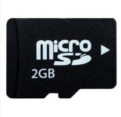
Secondary memory– Flash Card
Digital camera uses a slightly different form of solid-state memory, known as XD (extreme digital) or SD (secure digital) card.

Slide 19
Secondary memory–
Optical storage
An optical disc is the general term given to all formats of CD and DVD storage.
Unlike a hard disk with separate concentric tracks, an optical disc has a surface arranged in a long spiral.The spiral is a sequence of bumps and pits 凹凸 which encode the digital data.
The basic disc is made from plastic, coated 涂上 with a layer of aluminium.The reading of the bumps and pits is done with a laser beam 激光束. Data is read from the disc when the laser light is reflected from the aluminium layer and is received by an opto-electronic device that detects changes in light. The electronics in the player device then interprets 解释 the changes in light patterns as data bits.

Slide 20
Why DVD has lager capacity than CD?
DVD use the dual-layering which increase the storage capacity.
DVD 's track width are smaller, this means more data can be stored on the DVD surface
DVD use lasers with a wavelength of 650 nanometres; CD use lasers with a wavelength of 780 nanometres, the shorter the wavelength of the laser light, the greater the storage capacity of the medium.

Slide 21
The types
The data is already burned onto the disk. It can only be read
CD-ROM/ DVD-ROM
Write once only
CD-R / DVD-R
Can be written to or read from many times
CD-RW / DVD-RW
CD-RAM/DVD-RAM

Slide 22
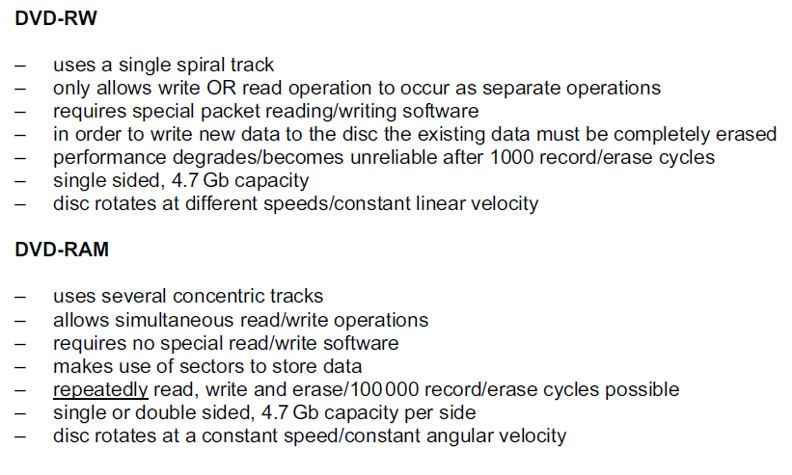
DVD-RW & DVD-RAM

Slide 23
Blu-ray disks
They are different to DVDs in their construction and in the way they carry out read-write operations.
The main difference:
A blue laser (rather than red laser) is used to carry out read and write operations
Using blue laser light means the ‘pits’and ‘bump’ can be much smaller, so it can store up to 5 times more data than DVD
Blu-ray uses a single 1.1 mm thick polycarbonate 树脂, DVD uses a sandwich of two 0.6 mm thick disks
Blu-ray disks come with a secure encryption system which helps to prevent piracy and copyright issue.

Slide 24
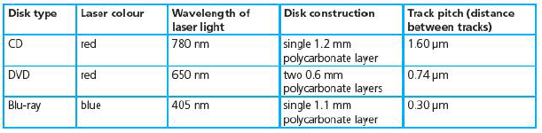
The difference between CD,DVD and blu-ray

Slide 25
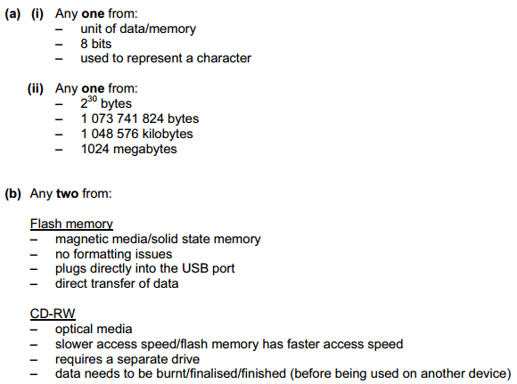
3.

Slide 26
4
(a)Any two from:
– Blu-ray discs use blue/violet lasers rather than red lasers as used by DVDs
– storage capacity of Blu-ray discs is much higher than standard DVDs
– Blu-ray discs use one polycarbonate layer; DVDs use two layers
– Blu-ray discs have a built-in secure encryption system
(b) Any two from:
– DVD has one spiral track; DVD-RAM has several concentric tracks
– DVD-RAM can be written to and read from at the same time; DVD-R only allows the read operation to occur
– DVD-R only allows data to be read (can’t write to it) whereas DVD-RAM allows reading and writing operation

Slide 27
5. Describe the main differences in the way the following back up systems store data:
-Memory sticks
-CD-RW(writers)
-Hard disk (drive)
Memory sticks: these are solid state technology.Memory sticks are usually small,portable devices which usually don’t require any additional software since operating system usually recognise them as the E-drive, F-drive,etc.
CD-RW:these storage media use the properties of light to write data and to read data from the disk surface.
Hard disk:the hard disk is used to store operating systems and applications software, Data is stored in a digital format on the magnetic surfaces of the disks

